Slide 1
OCR using Google Cloud Vision API
Submitted By : Ashish Bhoi
Gmail-ID : ashishbhoi1024@gmail.com

Slide 2
Python Modules Used:
os -> for file path joining and setting environment variable.
io -> for passing file to Cloud Vision API
pdf2image -> for converting pdf to image
google.cloud -> our base google vision API module
argparse -> For providing input file to software I am using argparse.
In here all above module are free or open source other than google.cloud which is paid service for commercial user. But I am using free trial version for this project.

Slide 3
Overview of Google Cloud Vision API
Google Cloud offers two computer vision products that use machine learning to help you understand your images with industry-leading prediction accuracy.
1) AutoML Vision
2) Vision API
We will be using Vision API in our software.
Vision API :-
Google Cloud’s Vision API offers powerful pre-trained machine learning models through REST and RPC APIs. Assign labels to images and quickly classify them into millions of predefined categories. Detect objects and faces, read printed and handwritten text, and build valuable metadata into your image catalog.

Slide 4
Vision API uses OCR to detect text within images in more than 50 languages and various file types. It’s also part of Document Understanding AI, which lets you process millions of documents quickly and automate business workflows.
Before we start using the service we need to enable the API
https://console.cloud.google.com/flows/enableapi?apiid=vision.googleapis.com&redirect=https://console.cloud.google.com&pli=1
By using the above link you can create new project and then enable Vision API for the project.
https://cloud.google.com/vision/docs/quickstart
This above is the quick start guide provided by google.
We will be using Document Text detection for our particular case.
DOCUMENT_TEXT_DETECTION extracts text from an image (or file); the response is optimized for dense text and documents. The JSON includes page, block, paragraph, word, and break information.

Slide 5
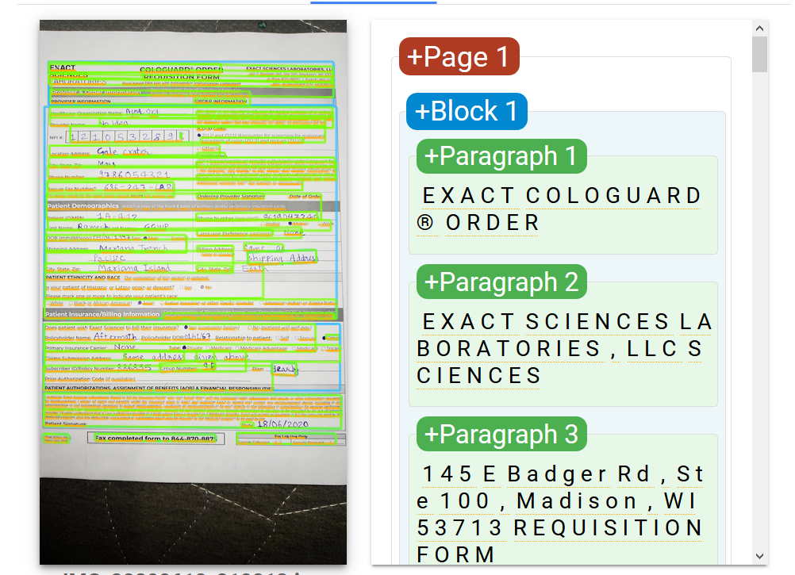
Example of OCR on Sample image provided earlier on google cloud website :-

Slide 6
Authentication of Vision API :
Google Cloud Vision API can be authentication using a service token which will be obtained by enabling the Vision API by link provided earlier.
The authentication key will be file which should be stored locally on the device which is using this Software.
In my project I have created a authentication file and will be providing it for the sake of testing for Hacker Earth campaign. So the judges don’t have to go through hassle of enabling the API.
I will delete this project from Google Cloud, after the Campaign is over and results are declared as it is for demo purpose only.
Generally we need setup environment variable/path to this secure key and then we can then use it in our software.
But I am removing this issue by providing key to the program at runtime.
By using below line in my code:
os.environ[‘GOOGLE_APPLICATION_CREDENTIALS’] = r’filename.json’
filename is the Name of Secure key obtained after creating project.

Slide 7
Code Logic :-
First of all I am enabling the Google Cloud secure key to use this service.
with:- os.environ['GOOGLE_APPLICATION_CREDENTIALS'] = r'serAccKey.json‘
Then I am calling argparse to provide input file to the program as an argument. (Ex. python file.py –i image.jpg. Here image is input passed.
After this I am checking if the file is a PDF or a JPG file, by checking file extension.
If file is a .jpg file then it can be passed directly to Google’s Vision API.
If file is a .pdf file then it will be converted to .jpg file first using the pdf2image python module.
The converted file will be stored in the images folder of project folder as img_1.jpg, img_2.jpg,… so on for each page in pdf file.
Now copy the image file name for which you wants do OCR and then
pass this name when prompted by software to pass image file name. Continue…

Slide 8
Then I am creating Vision API client and passing the input file as binary data to the Vision API.
Vision API will return the json response which I am converting to text only(removing extra information) and storing it in a variable named doc.
Then I am checking if it is first page or second page of sample form provided in the campaign.
As first page and second page have different format so we need to use different technique for character recognition.
For checking above I am first extracting top 10 lines of the result doc and checking if these lines contain word “REQUISITION” , if this word is present then it is the first page if not then It is second page.
Then I am doing two if loops for the two pages if it is first page then
first ‘if’ loop will run and if it is second page then second ‘if’ loop will run.
continue…

Slide 9
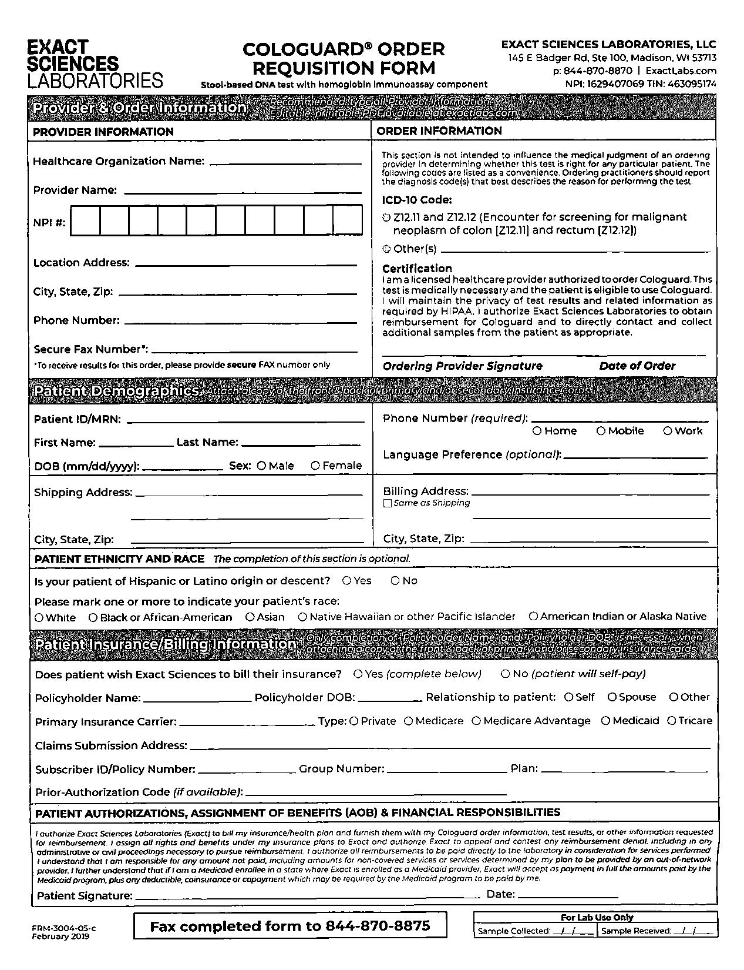
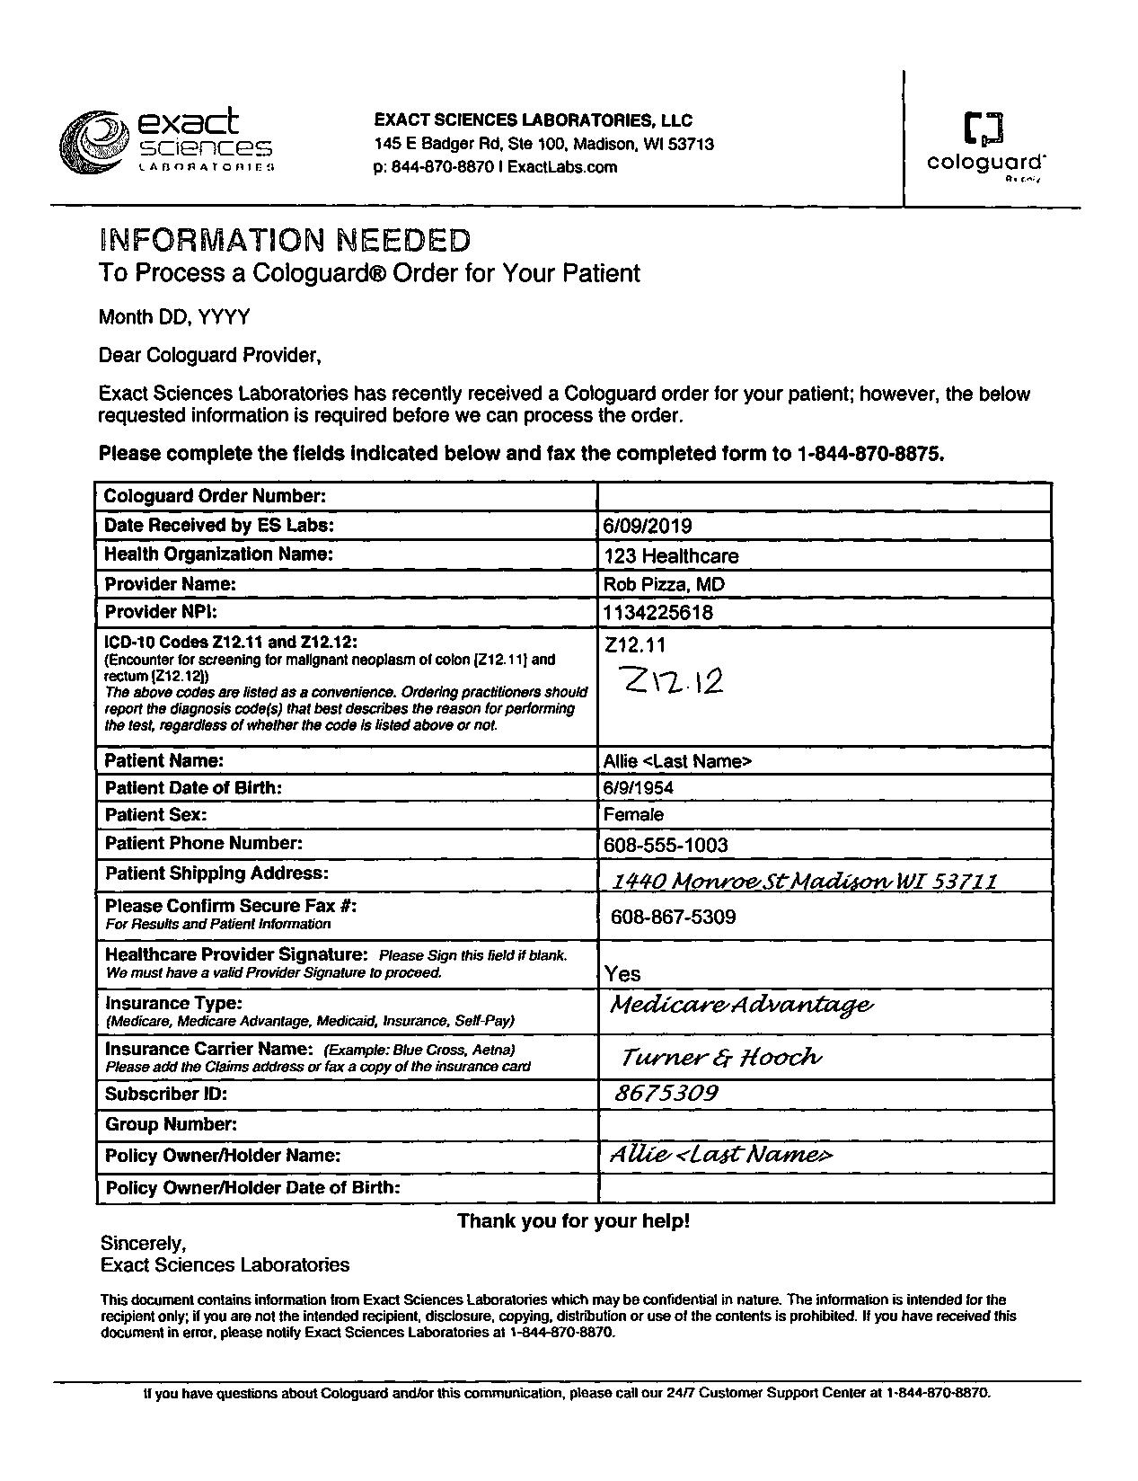
First Page of Sample form
Second Page of Sample form

Slide 10
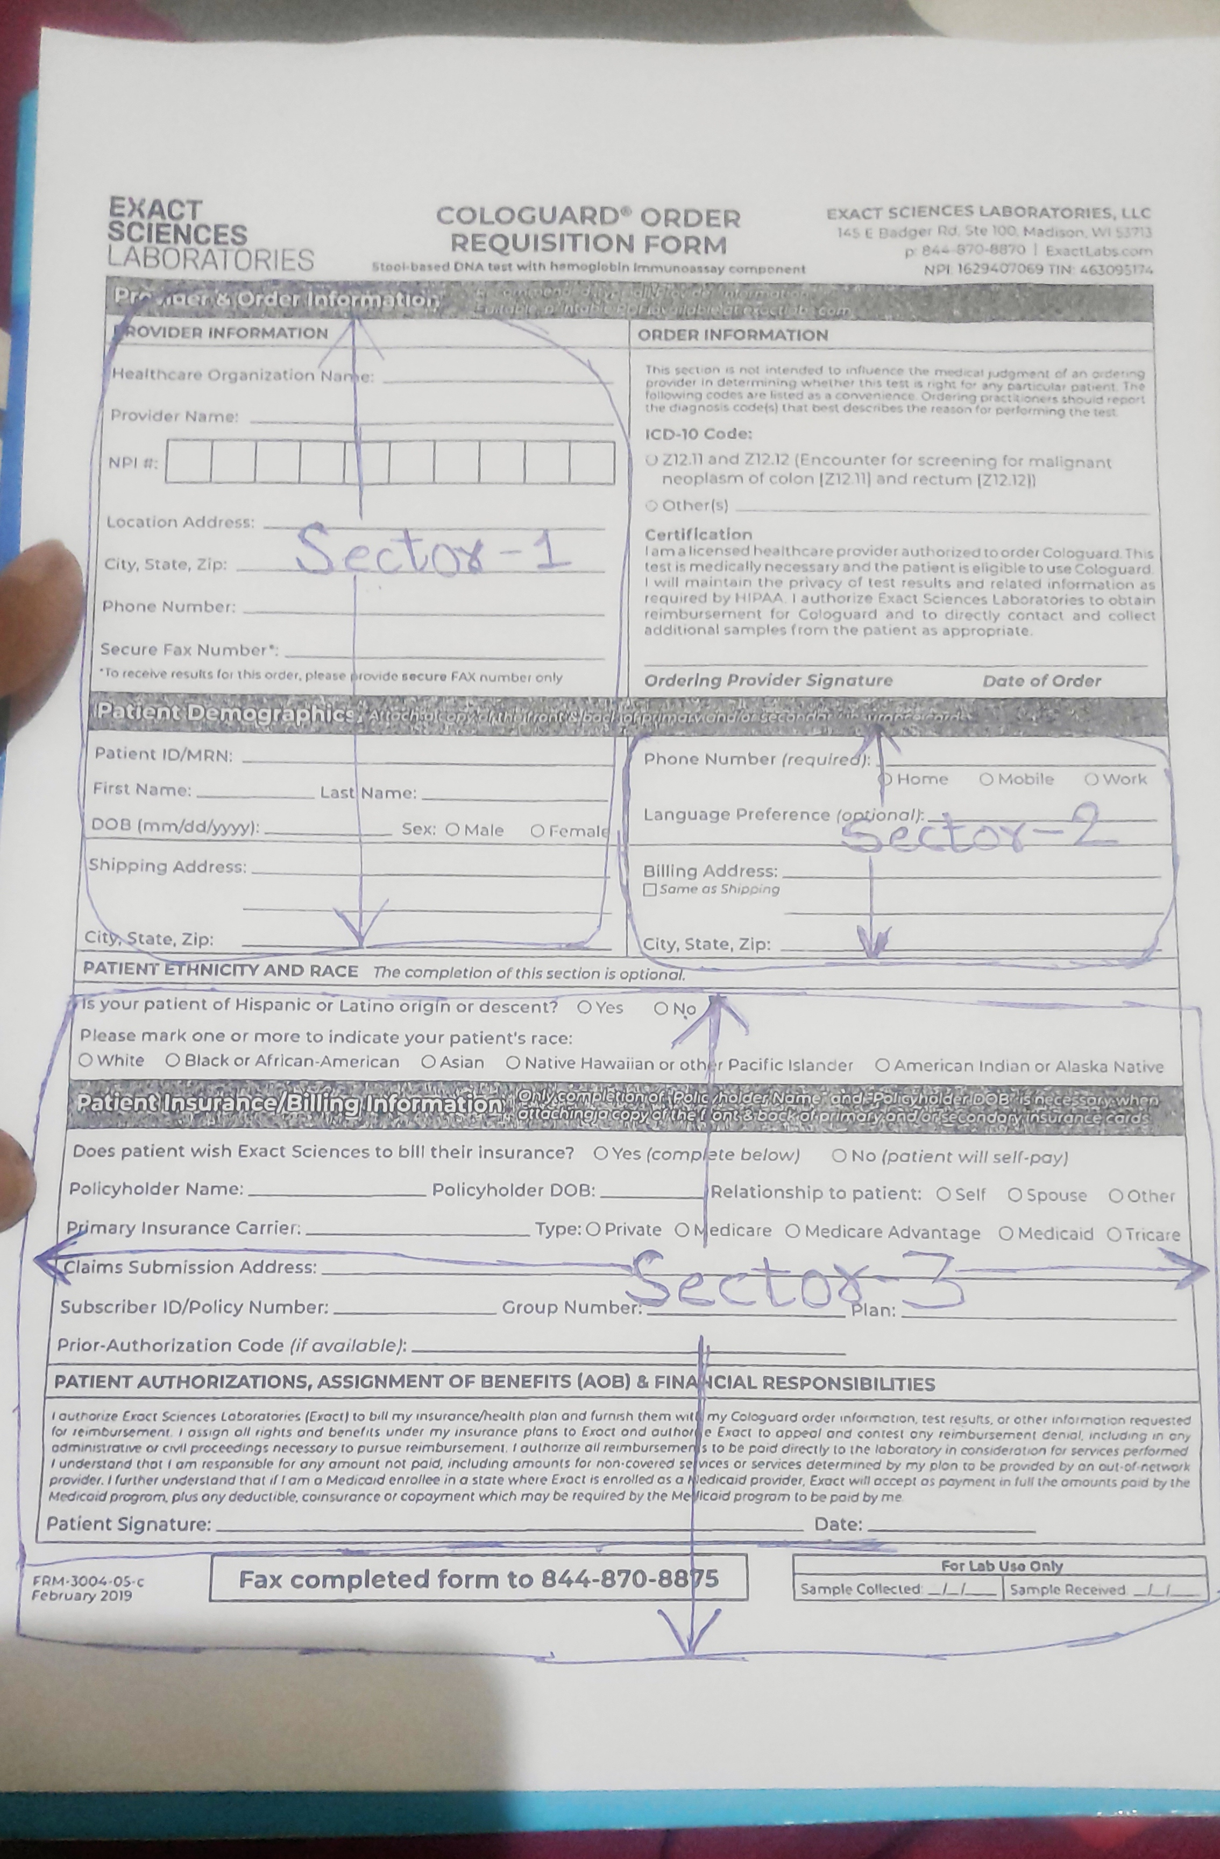
For the first page I am splitting in 3 parts named Sector 1, Sector 2, Sector 3
As it is shown below in the image :-

Slide 11
Then I am extracting data from the first page Sector wise and printing it in json format on the console/terminal.
I am also creating a text file named image_1_data.txt and saving data here in json format sector wise.
If second page is provided then also my program will automatically recognize this page and then do the OCR on it to extract the required fields.
For second page I am also printing data on the console and also putting it all in a file named image_2_data.txt in json format.
So time taken to run the software on first page or second page is 3-5 seconds per page.
I am extracting required field by using various string formatting techniques like .find() method to find a keyword, .replace() method to replace some string which is not required or for removing unwanted space and newline characters.
For writing into file I am using python’s f.write() method and for opening file I am using with open() method so that we don’t have to use close() method and don’t have to mess around with issues of file pointers not closing properly.

Slide 12
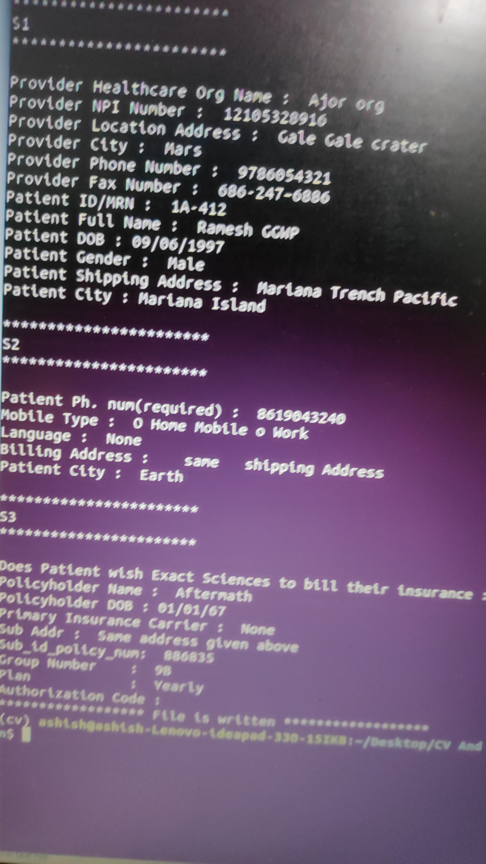
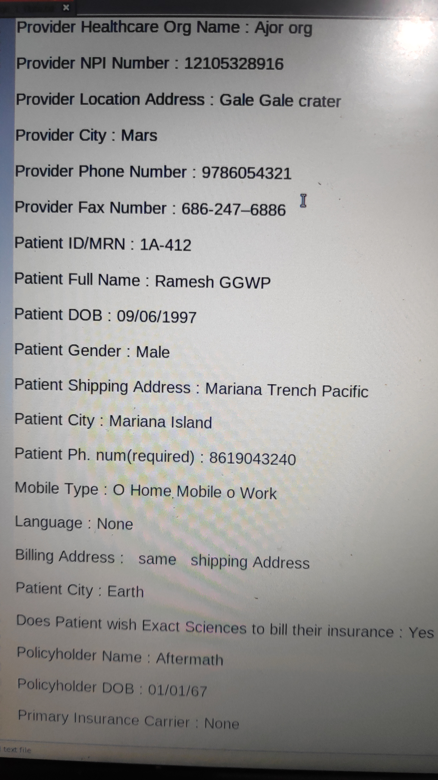
Sample images of result of First page OCR (Console + image_1_data.txt file)
S1 is sector one data, S2 for sector 2 and S3 for sector 3
Console output
image_1_data.txt file

Slide 13
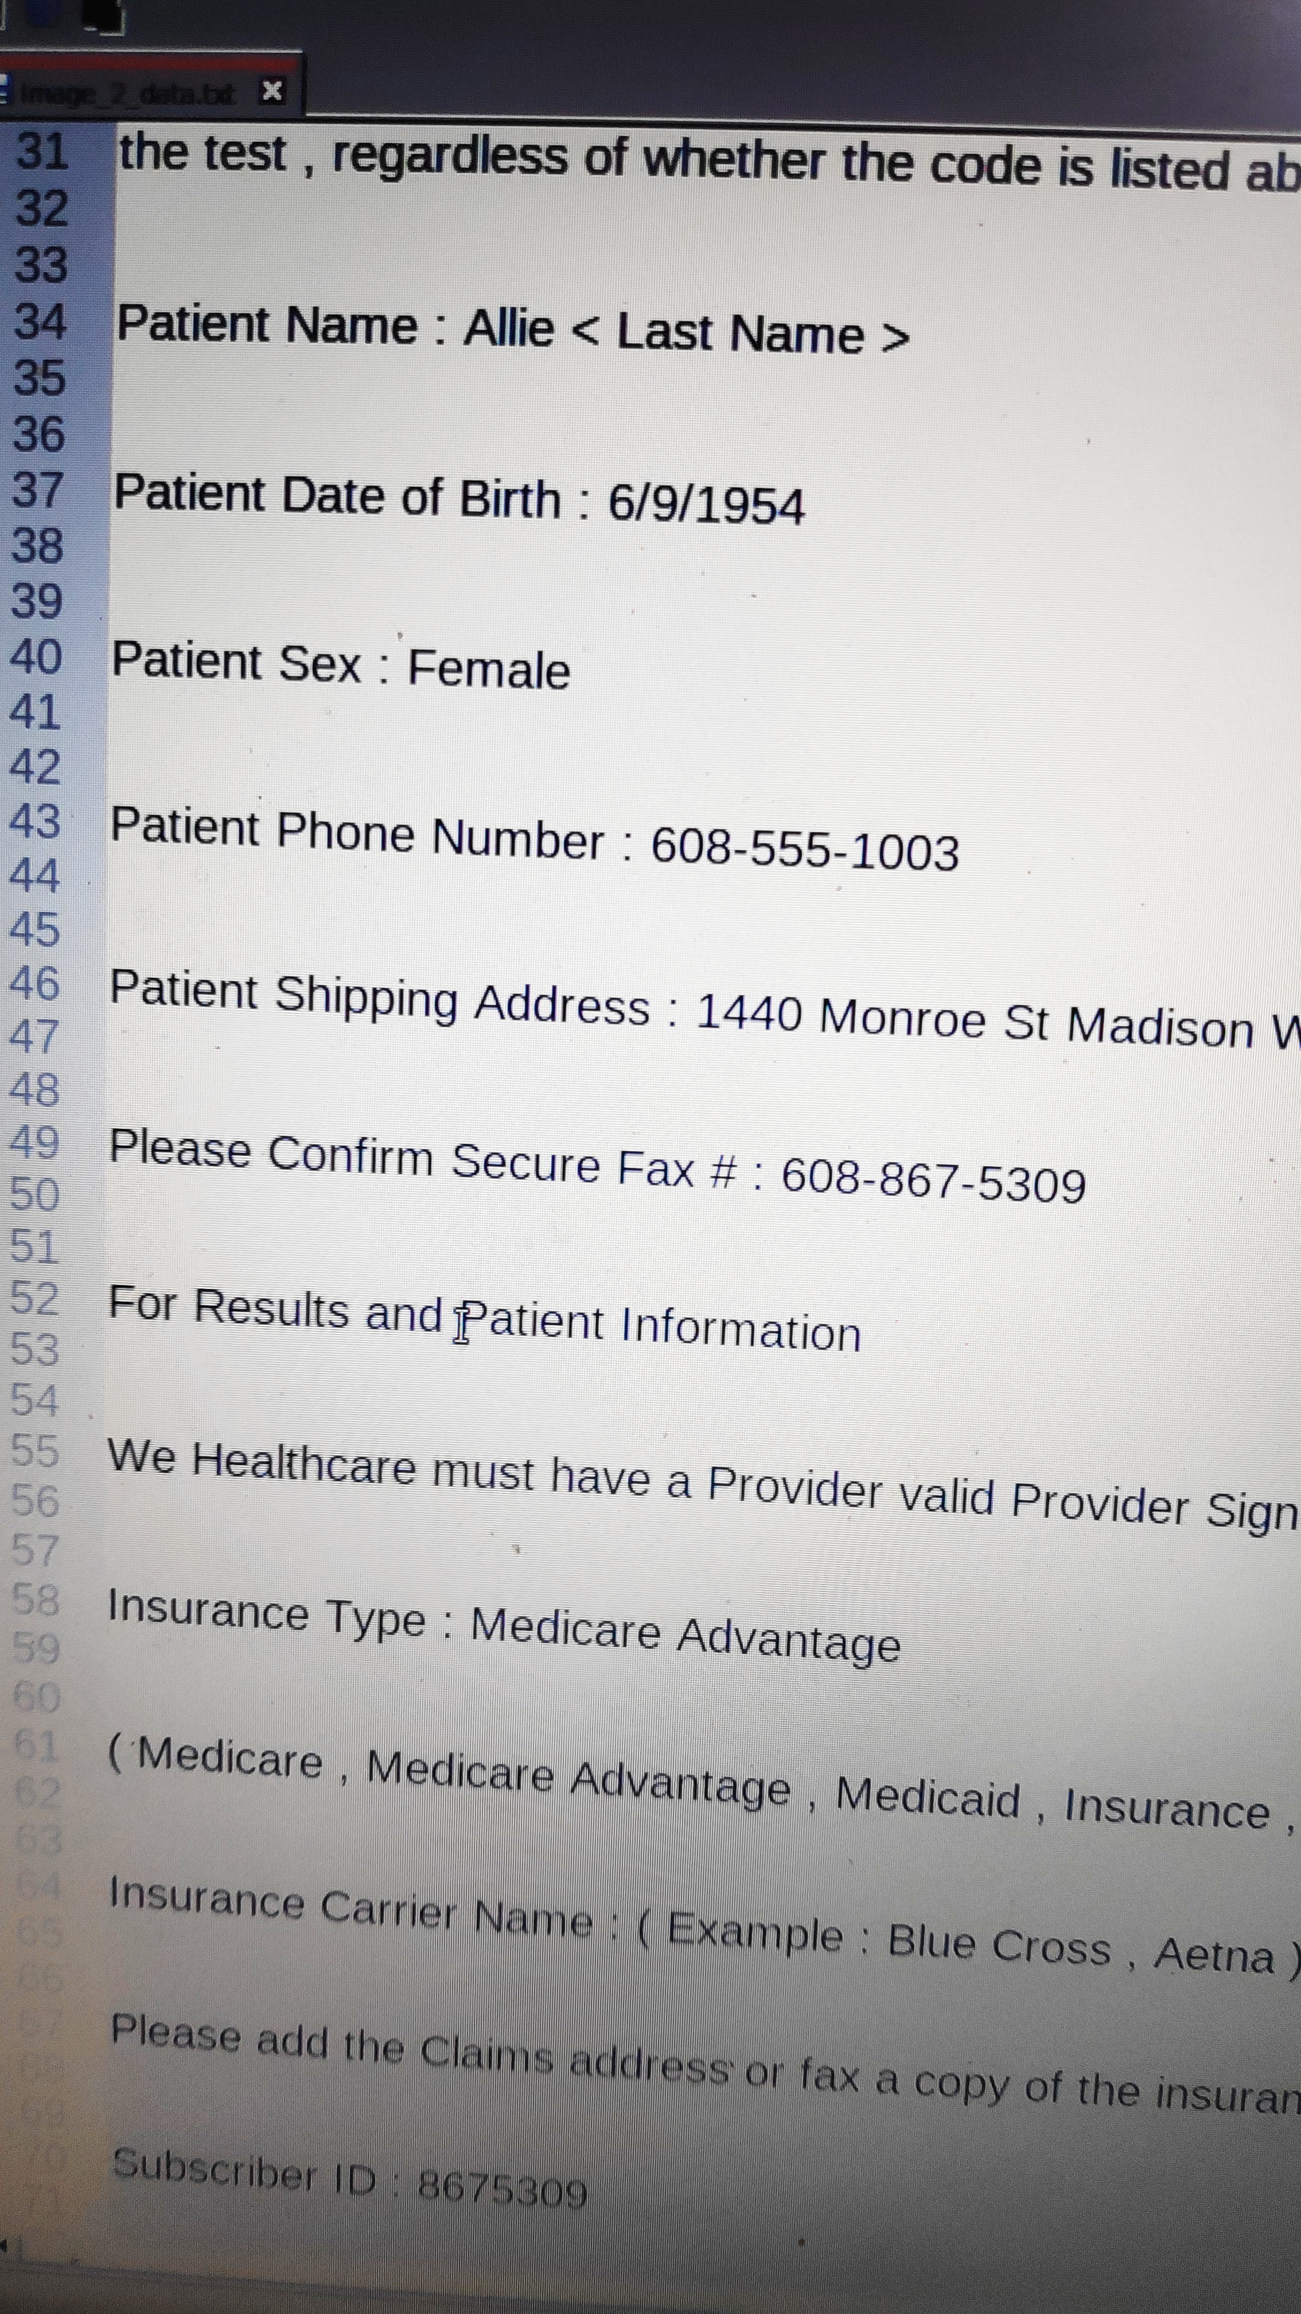
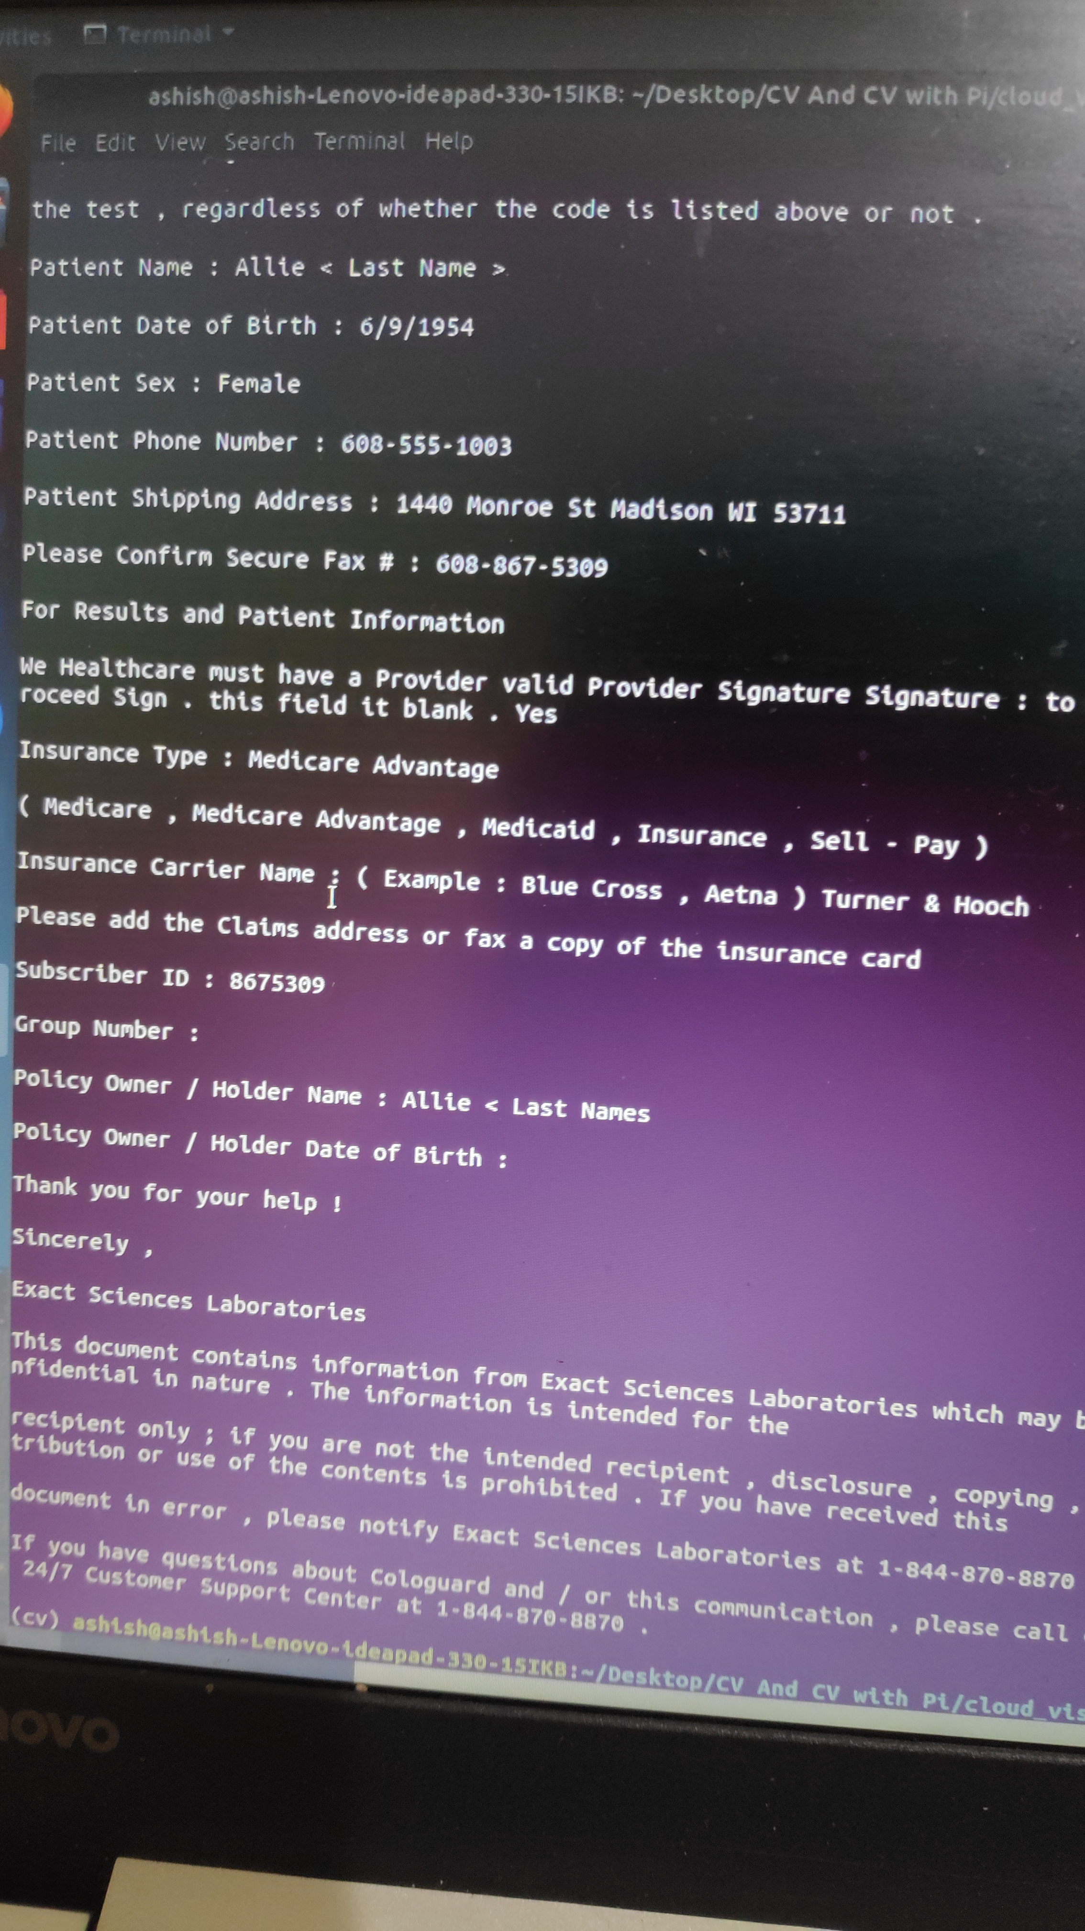
Sample images of results of second page OCR
Console output
image_2_data.txt file

Slide 14
Thank you!

